Slide 1
St. Timothy’s Property Sale – Drainage Improvements

Slide 2
Property Sale
SD-39-062 Rosedale Hills Drainage Improvements, Phase II
Construction of dry detention basin
Bank stabilization along east bank of Dodrill Creek
Geotextile underlayment
Riprap armoring

Slide 3
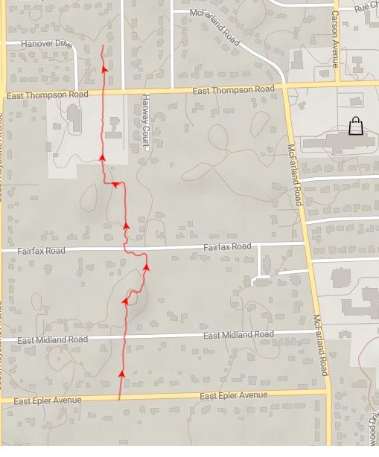
Dodrill Creek

Slide 4
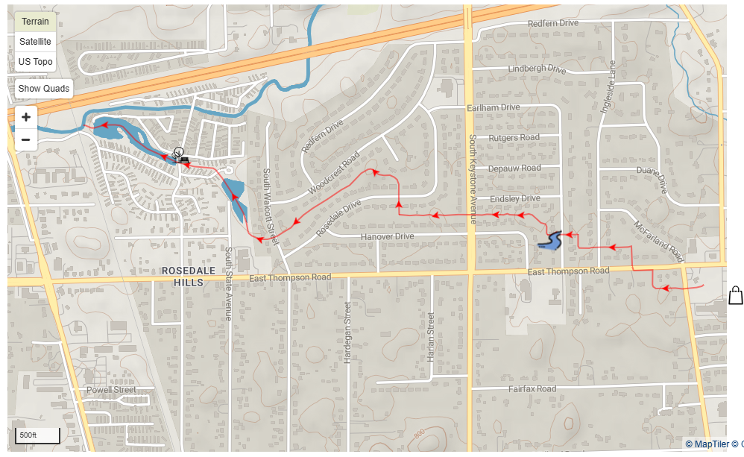
Lowman Creek

Slide 5
Property Sale - Financials
Purchase price was $94,000 but costs for embankment stabilization were deducted (~76 tons of revetment riprap)
St. Timothy’s net is $75,500
Diocese deposited this to St. Timothy’s Special Funds (Investment) account on 31Oct2024
Vestry to determine how to use this money
Total Special Funds value is now approximately $84,500

Slide 6
Property Transaction Details
Construction timing is unknown but likely to start in Spring, 2025
City will be responsible for property maintenance
Sold property is west of creek and roughly everything between creek and Nazarene church, from Thompson Road on north to mid-parking lot on south

Slide 7
Pictures
Property is roughly blue-green shaded area

Slide 8
Pictures
Showing approximate shape of dry detention pond and embankment work

Slide 9
Pictures
Showing embankment work
Compacted, Vegetated Fill
Revetment Riprap
Toe of Slope
Geotextile Fabric

Slide 10
Pictures
Showing area of embankment work
Revetment riprap to be installed on existing channel bank where erosion is present. See cross section on sheet PP24.

Slide 11
Pictures
All contours south of Thompson Road are based of LIDAR(?) data with the exception of the Thompson Road crossing and Lowman Creek
Showing construction notes
Proposed grading lines(?)
Permanent erosion control blankets to be installed on berm slope

Slide 12
Pictures
Showing proposed grade for dry detention basin
Basin
Creek

Slide 13
Pictures
Showing proposed grade for Lowman Creek bottom
Existing grade

